Slide 1
Photo Album
by P.Samatha Ramakrishna

Slide 2
If you're using RxJS in conjunction with a larger application framework, you probably have multiple APIs available to make AJAX requests to your server to get data; however, if you like receiving your data wrapped in observables and your framework of choice doesn't return HTTP responses that way, then you can use the ajax function that ships with RxJS.

Slide 3
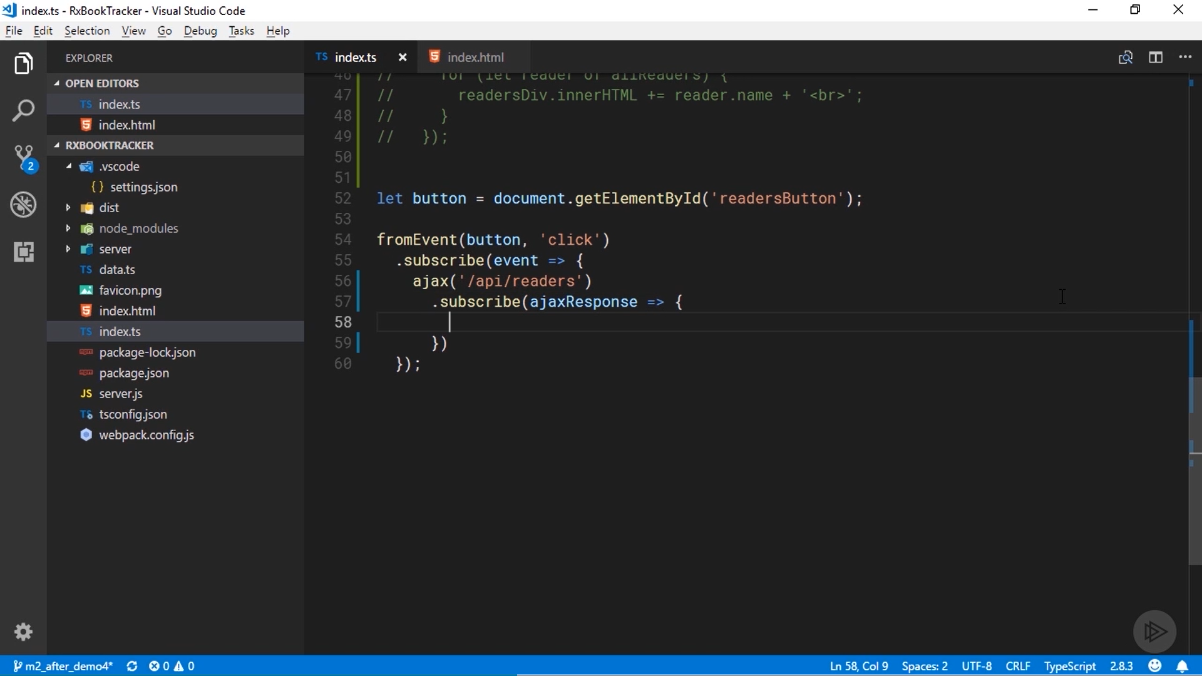

Slide 4
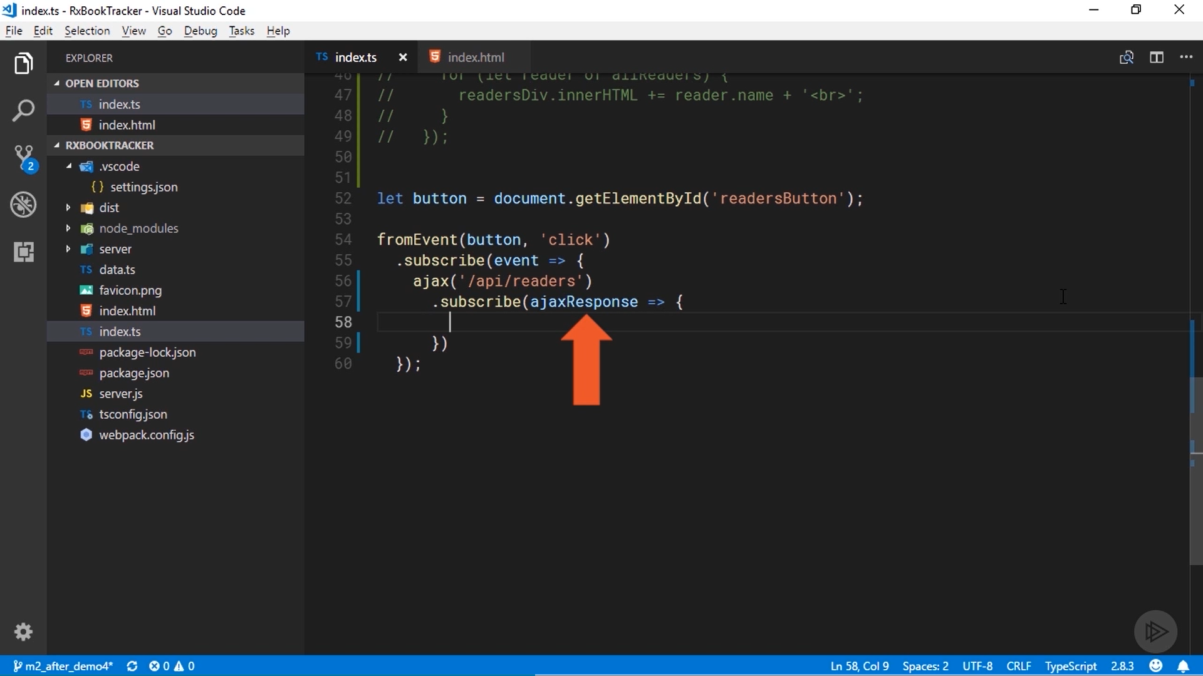

Slide 5
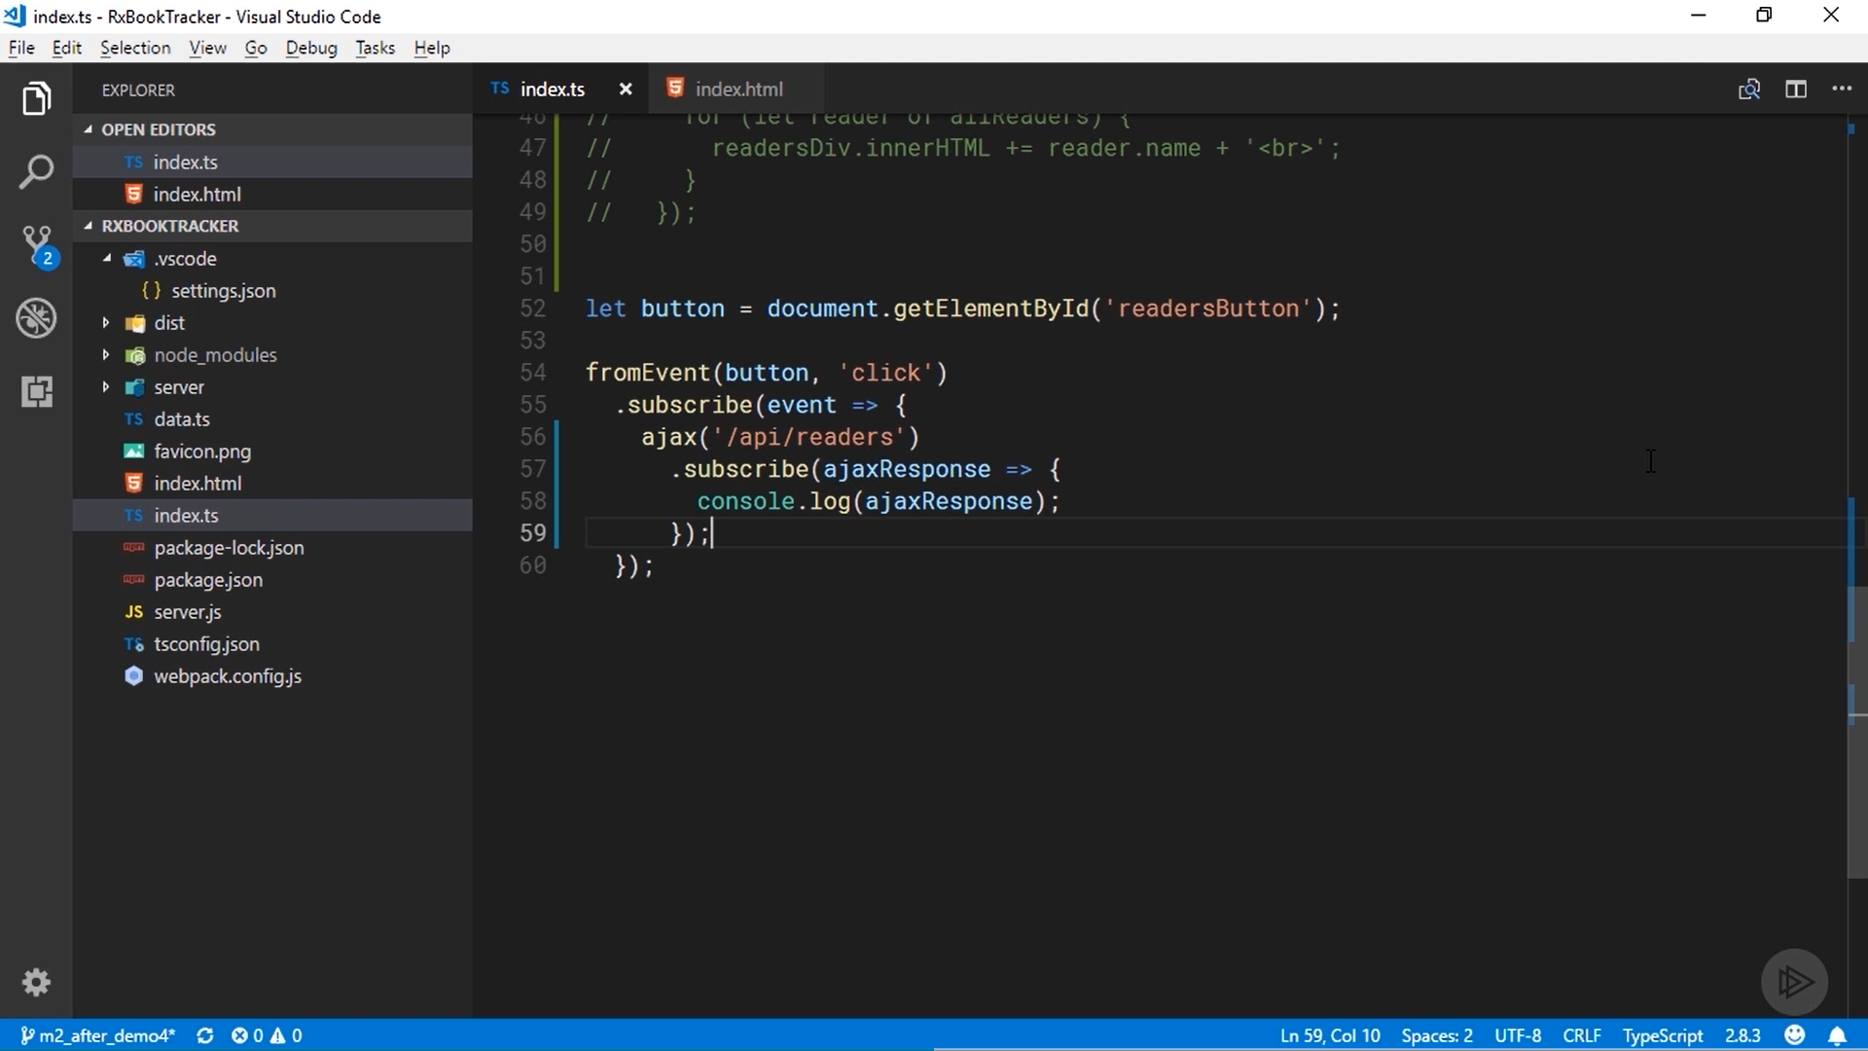

Slide 6
, I'm going to make an AJAX request to the server to get a list of readers. In the handler for the click event, I'll call the ajax function I imported. It takes a string URL as a parameter. The URL that will return me a list of all readers is \api\slash readers. The ajax function returns an observable, so I'll chain on to it a call to subscribe. The value produced by this observable will be an ajaxResponse, so I'll make that the parameter for the callback function that will handle the produced value

Slide 7
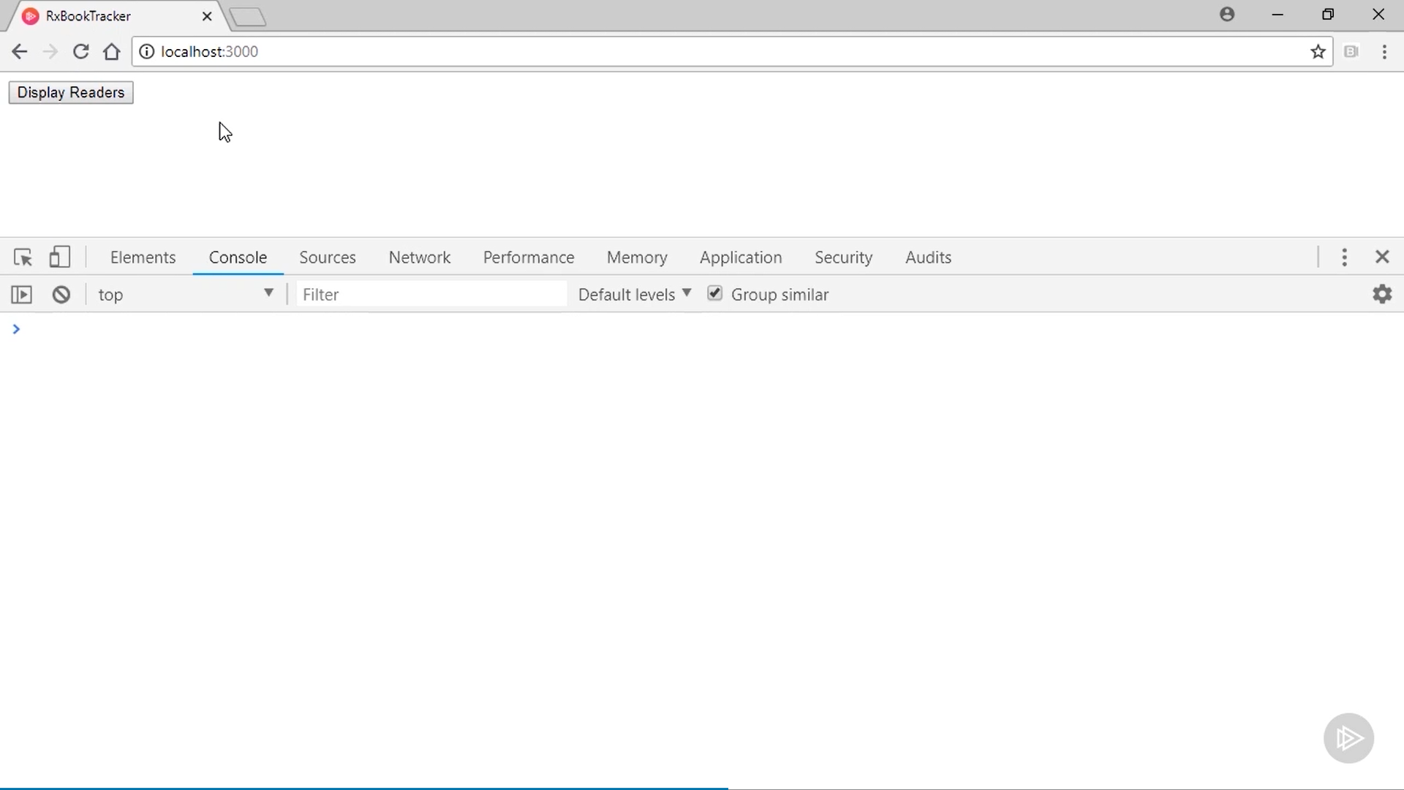

Slide 8
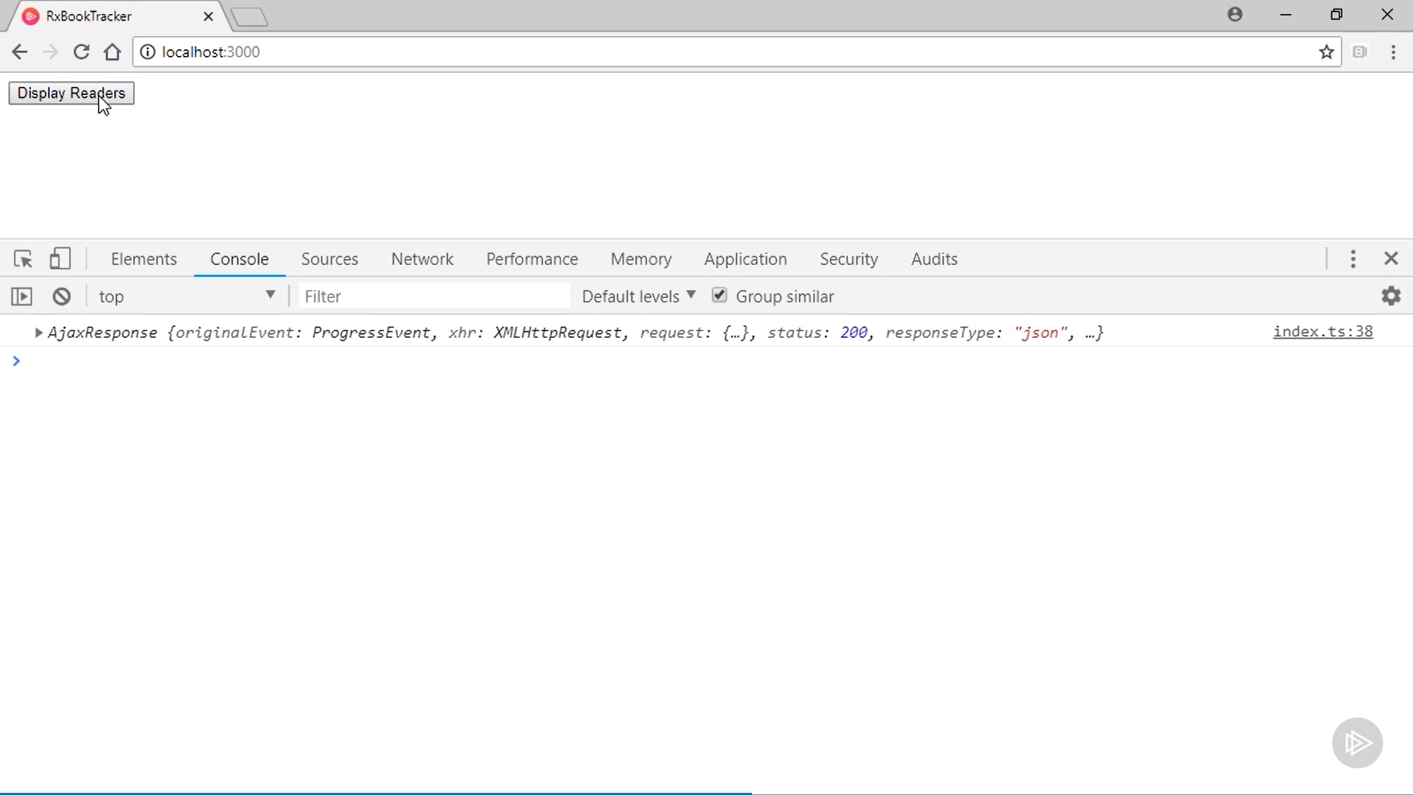

Slide 9
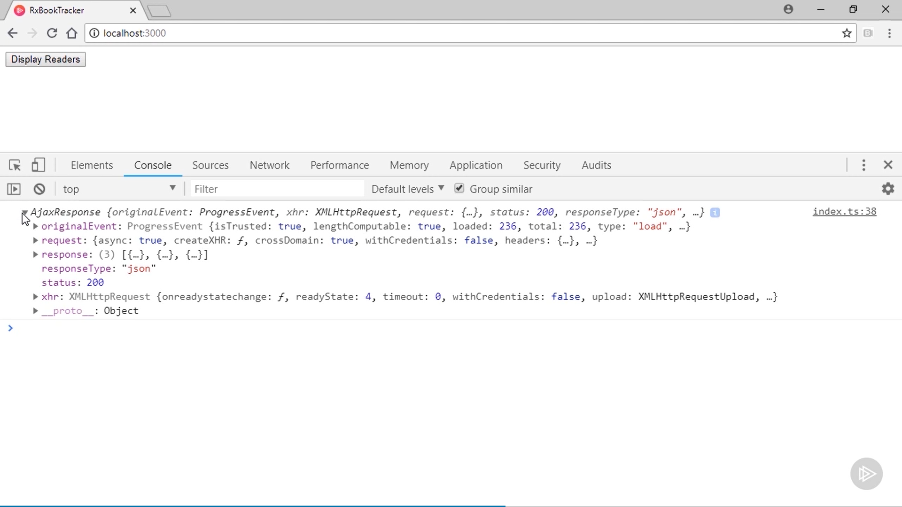

Slide 10
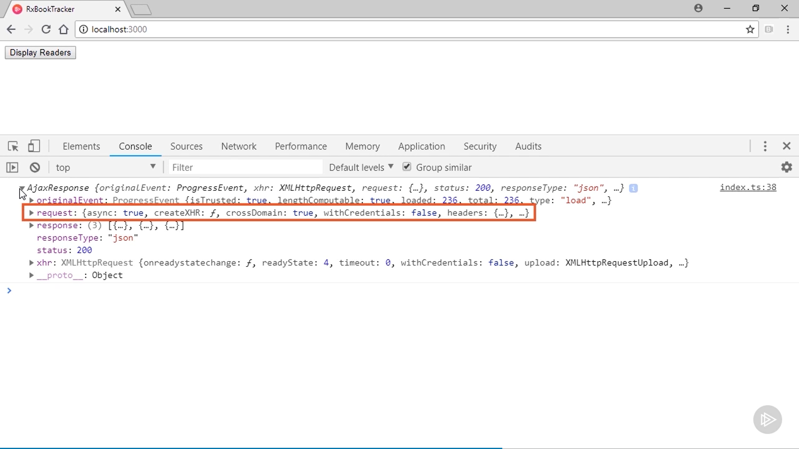

Slide 11
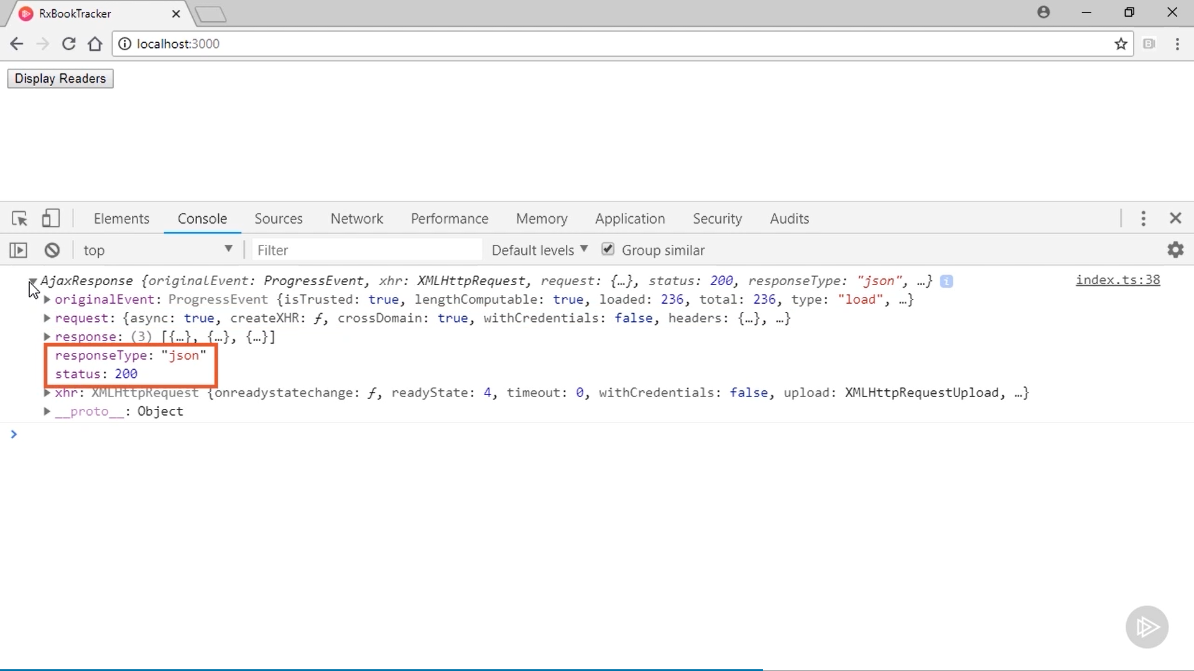

Slide 12
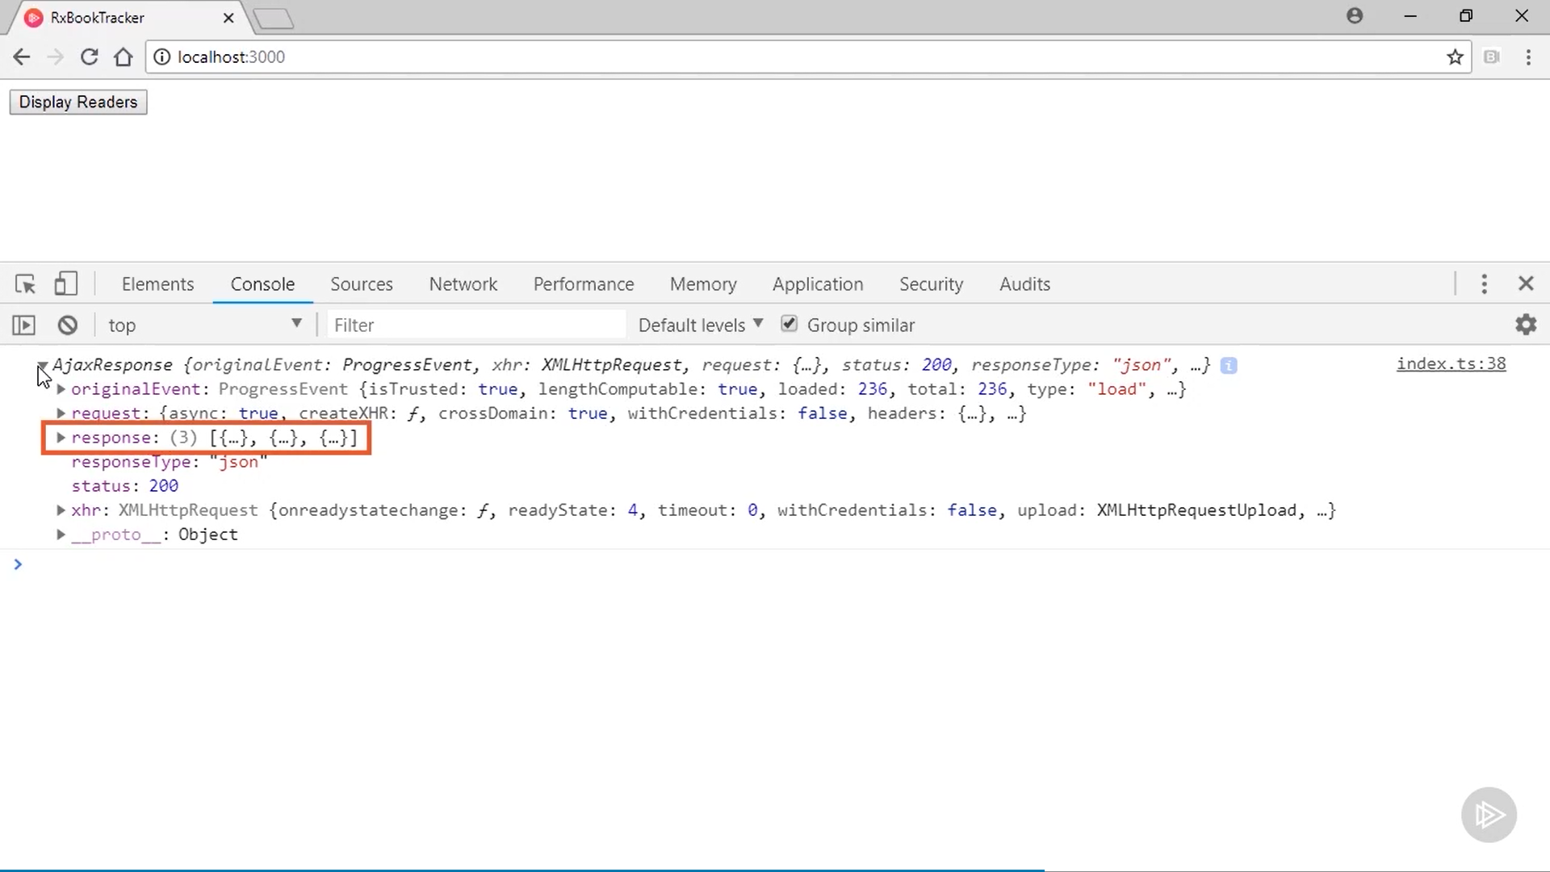

Slide 13
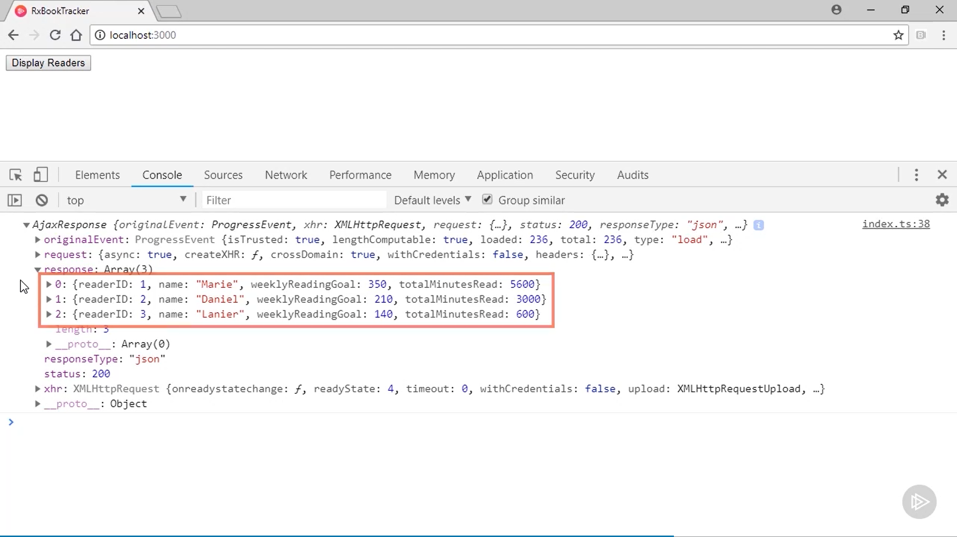

Slide 14
Before I attempt to print the names of the readers to the page, let's just log the AjaxResponse to the console and run it one time first. I'll refresh the page and then click the button to initiate the request to the server. We can see in the console the response from the server. I'll expand it so we can see what types of data it includes. This response object is the value produced by the observable returned from the call to the ajax function. You can see that it includes lots of HTTP-specific information. You can get lots of information about the request, you can see the HTTP status code that was returned, and the type of data contained in the response. The actual reader data is in this response property. I'll expand it, and you can see it contains the 3 reader objects we want to display on the page. Let go update the code to do that. I know the array of readers is stored in the response property on the ajaxResponse,

Slide 15
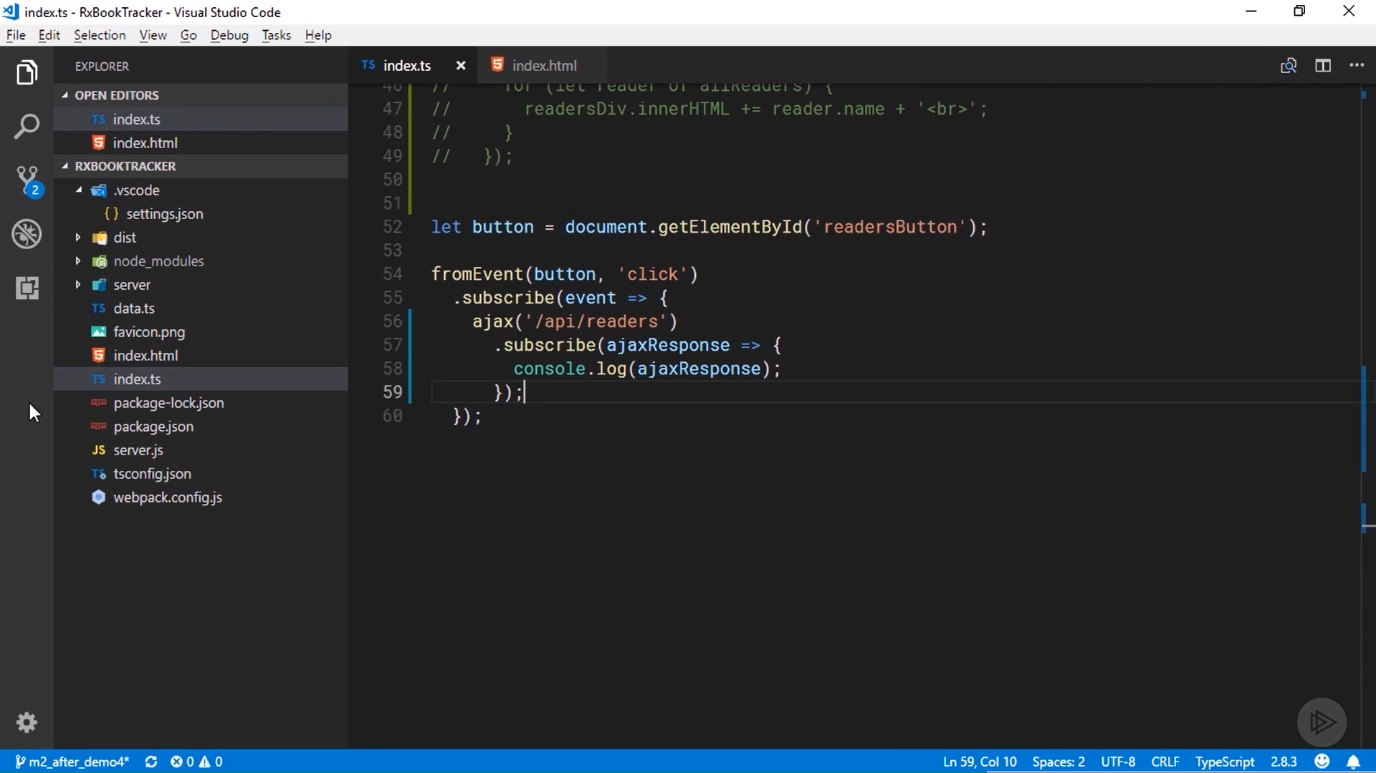

Slide 16
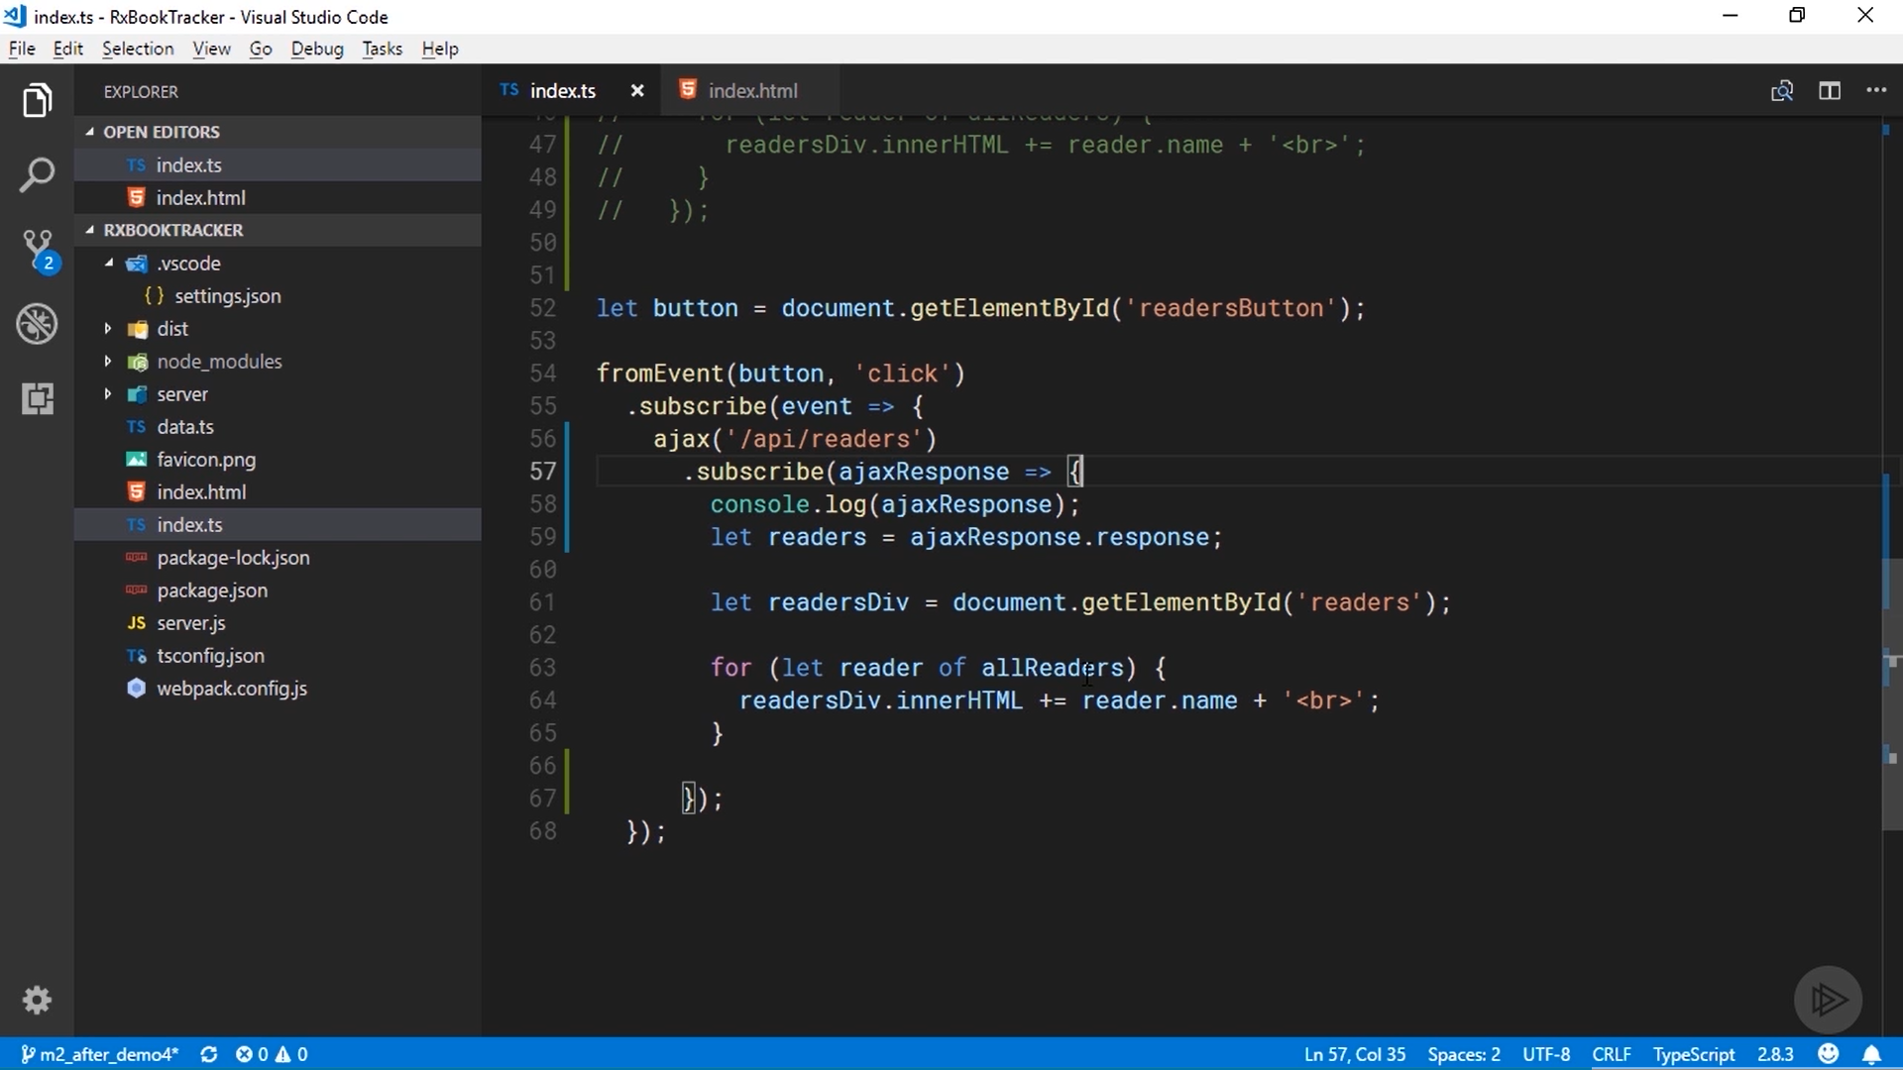

Slide 17
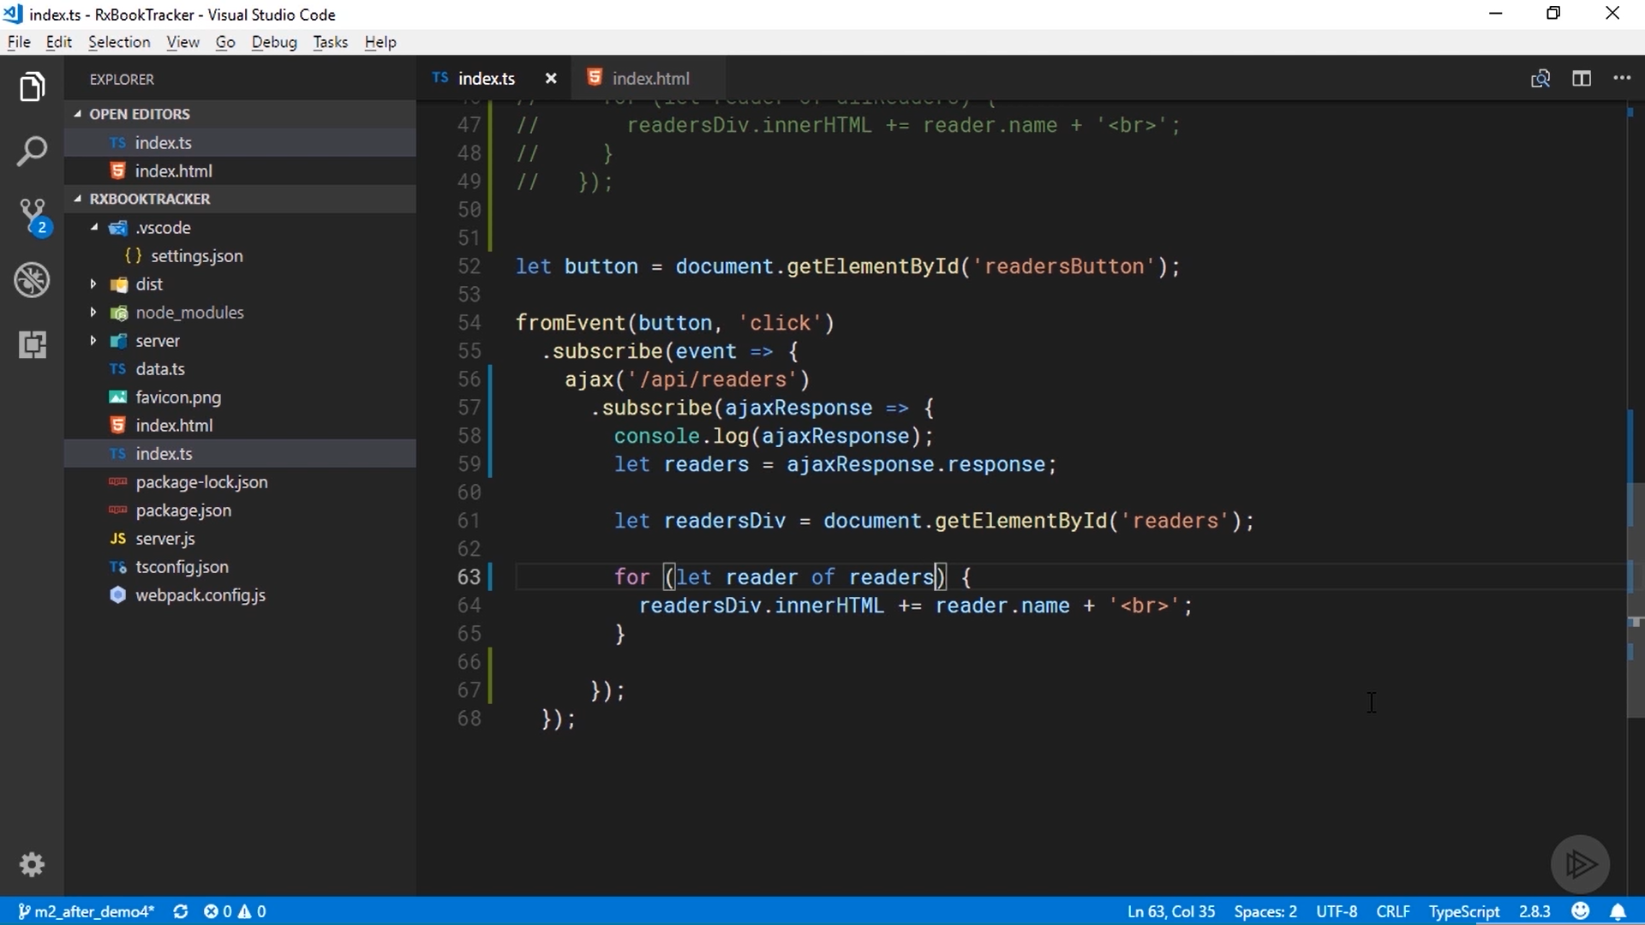

Slide 18
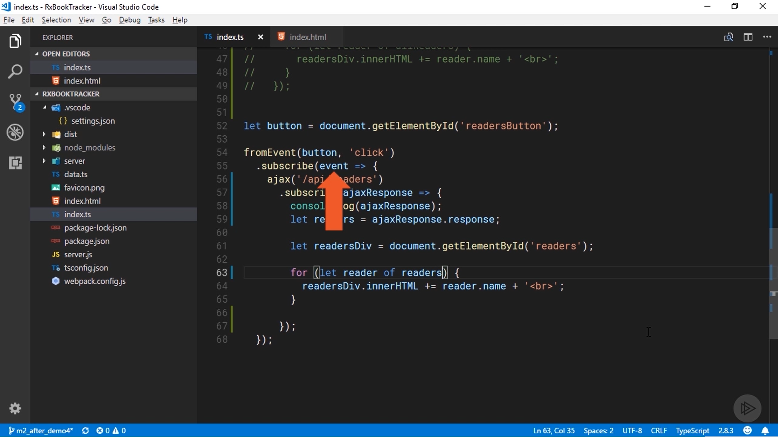

Slide 19
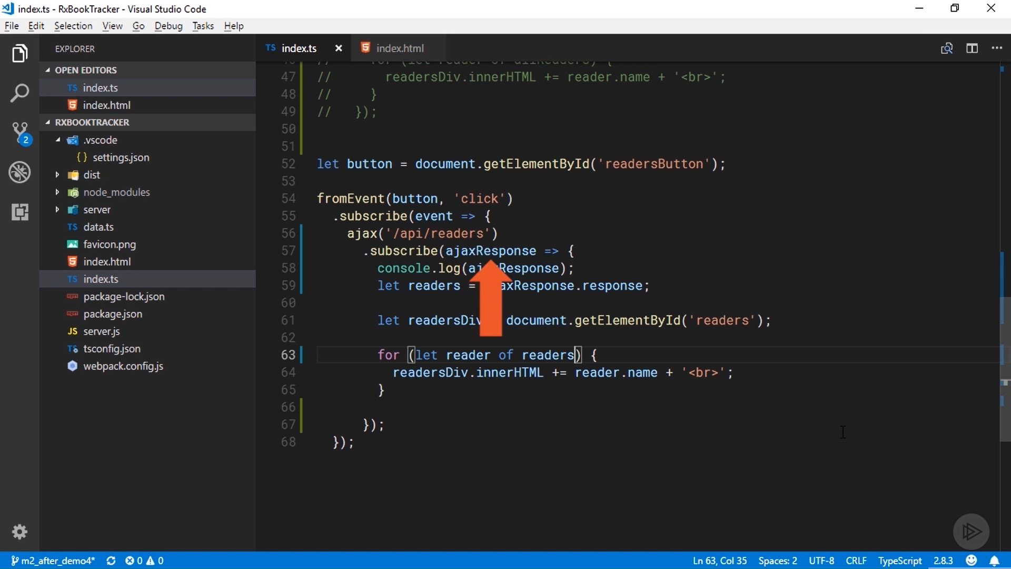

Slide 20


Slide 21
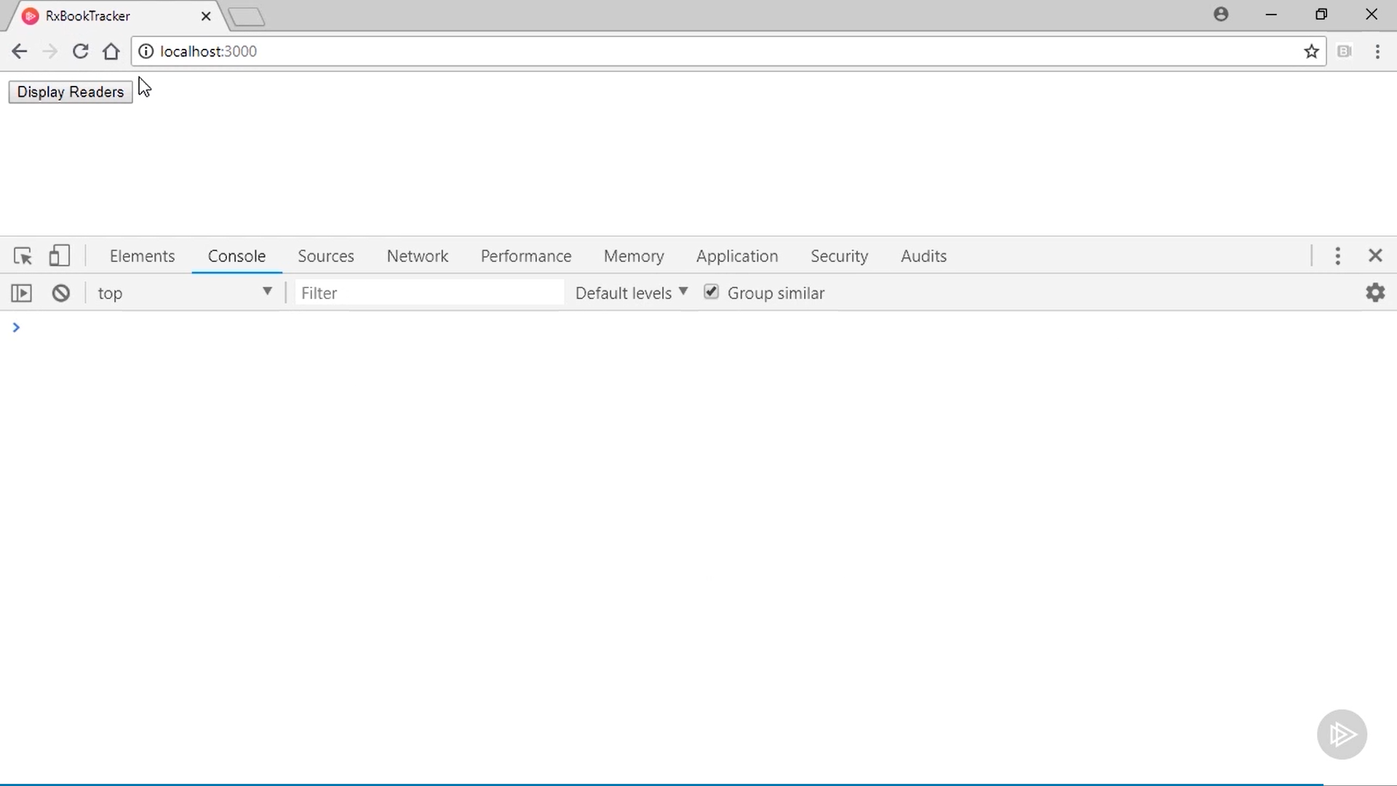

Slide 22
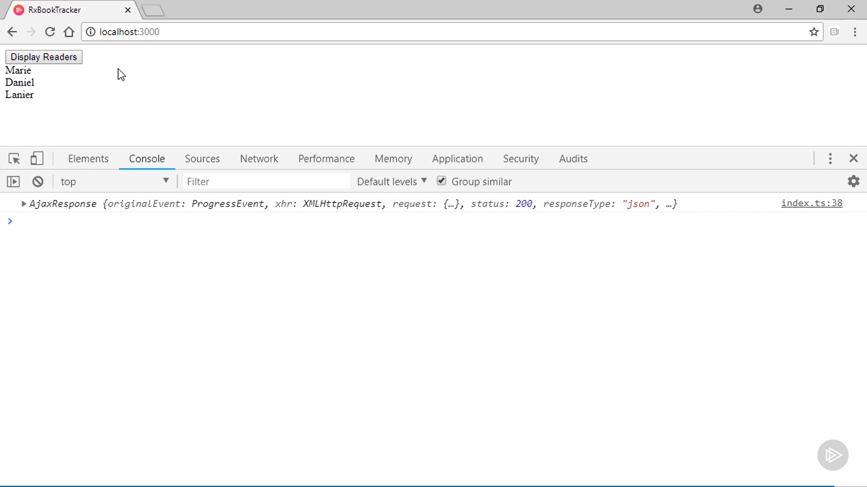

Slide 23
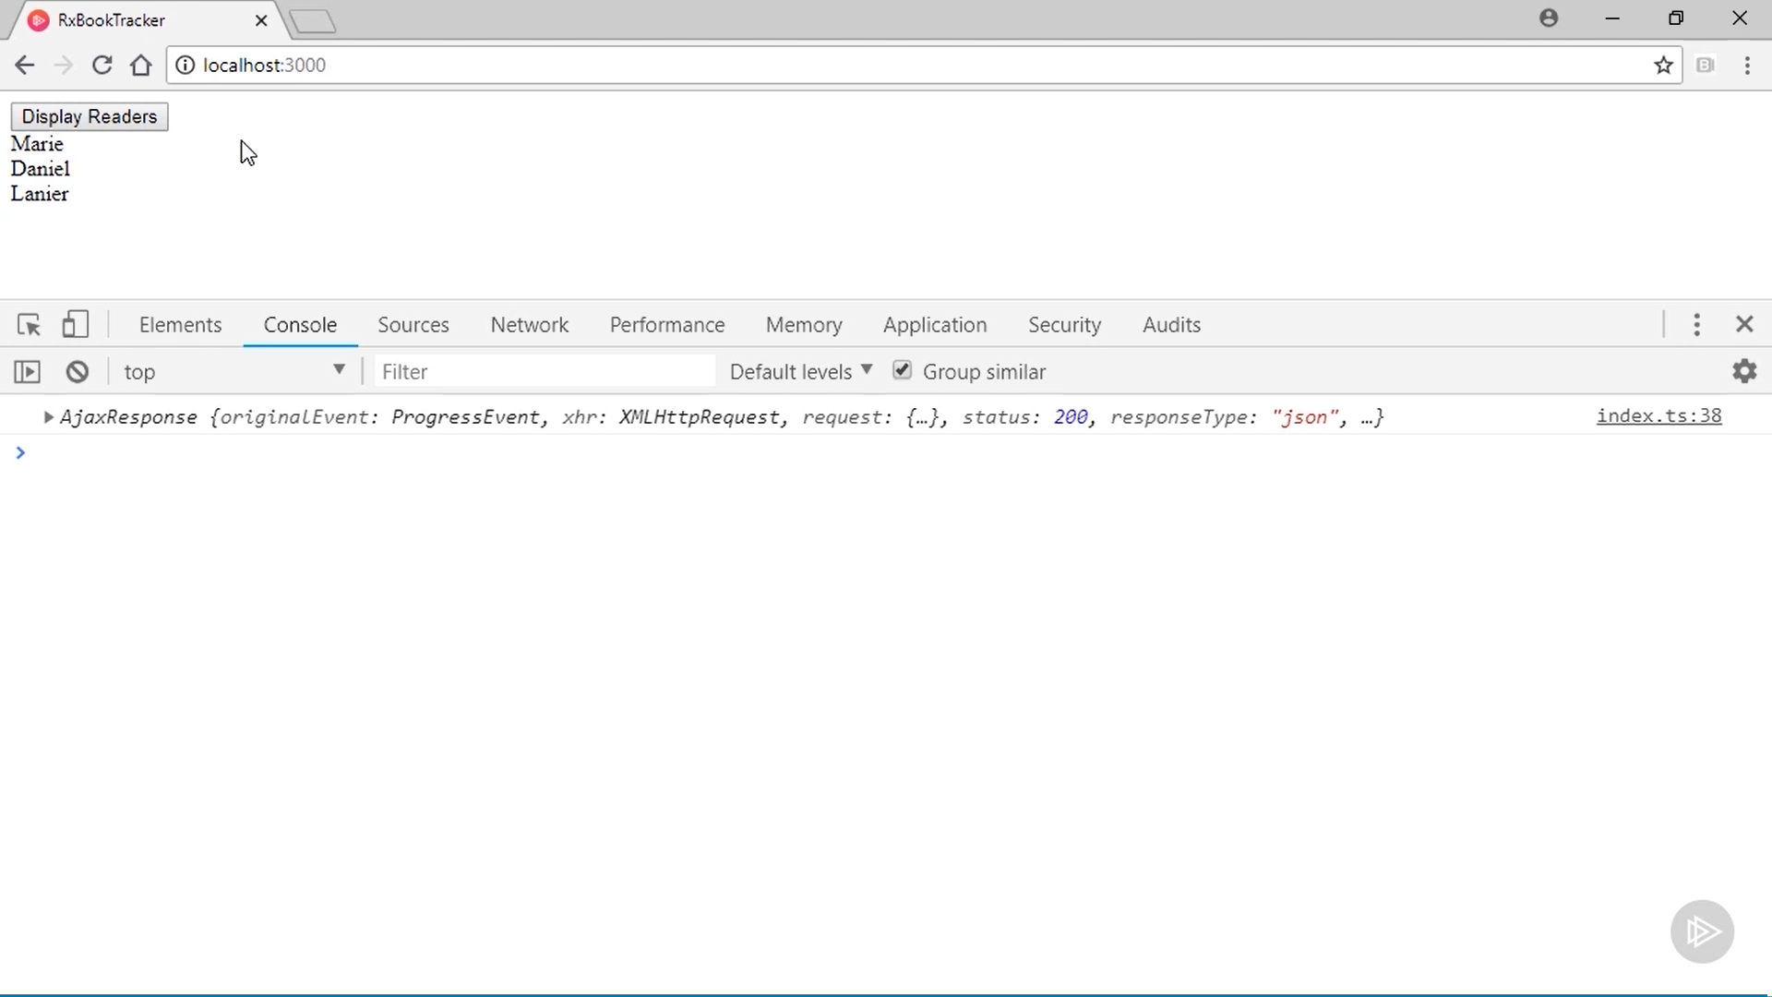

Slide 24
so I'll assign that property to a variable. I now want to iterate over that array and print the readers' names to the screen. I'm going to copy the code from the last demo that did that and paste it into this new example. The only thing I need to change is the name of the array I'm iterating over, allReaders should actually be the readers variable I declared above. Okay, this should produce a result similar to the example from the last demo; however, this time I'm using two observables. The first one will produce the click event from the button, and the second one will produce the HTTP response from my request to the server. I'll quickly jump back to the browser and make sure it works as expected. Looks like it does. I've still got the HTTP response logged to the console and the names of the readers are now printed to the page.

